Slide 1
Pre-treatment and flare in Cambodia

Slide 2
Contents
A
B
C
D
Pretreatment operation
Maintenance of Pretreatment
Biogas Flare operation
Maintenance of Biogas Flare

Slide 3
Pre-treatment operation
Starting Steps:
1. When it is the first time to start or desulfurizer is renewed, there is a need to blow air into the scrubber unconnected to the inlet pipe of biogas generator. Steps for blowing are as follows:
1) Disconnect the biogas pre-treatment with biogas source pipe ahead and gas generator inlet pipe(It is not necessary in this project, we just need to open the drain valve on the wall and close the valves of generators and flare.)
2) Open all the valves of the system.
3) Manually pull the belt of roots blower to ensure it is not stuck.
4) Inching jog the roots blower to make sure it works normally.
5) While roots blower is working, test the outlet dust content via a stick wrapped up with white gauze. The air blowing will not stop until yellow dust is not seen on the white gauze.
6) Connect the inlet and outlet flanges of skid-mounted biogas scrubber. (Close the drain valve on the wall)
2. After air blowing for the first time or a long time(around 3 to 6 months) continuous shut down of roots blower, it is necessary to displace air in the pipes with biogas. Displacement steps are as follows:
1) Disconnect the outlet flange of biogas scrubber with connecting pipes of gensets. Then connect the outlet of scrubber with the outside of genset room(we can also open the drain valve on the wall);
2) Open all the valves of the system;
3) Manually pull the roots blower to ensure it is not stuck;
4) Jog the roots blower to make sure it functions well;
5) Start the blower, then sample the gas from the outlet of the drain valve until the oxygen equal or less than 0.5%;
6) Connect the outlet pipe of skid-mounted biogas scrubber to the inlet pipe of the biogas generator( close the drain valve);
Before start the skid-mounted biogas scrubber every time, the drain valves of desulfurization tank and separator should be opened to drain water away.

Slide 4
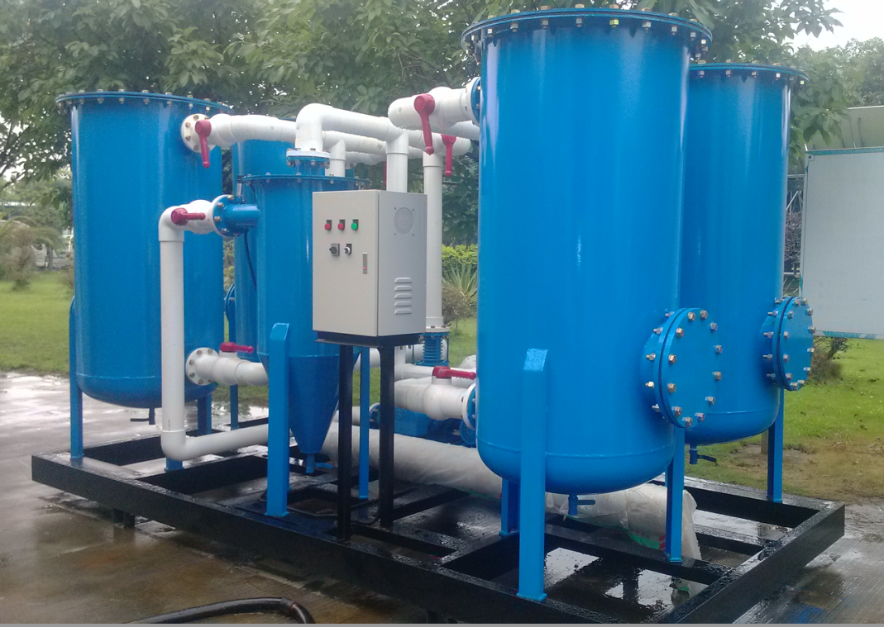
Biogas pretreatment electric control box operation
1, Check if the pipeline valve is open to ensure the pipeline is smooth;
2, Check if the mains power and power generation in the cabinet are connected properly, close all the MCB in the cabinet, and switch the power selection switch on the panel to the mains gear. Then, the panel power indicator (red) is on, the inverter is powered;
3, Turn the start-stop selection switch on the panel to the start gear (on the right), start the inverter, and observe whether the Roots blower is running normally. Then, the running indicator (green) on the panel is on.
4, Check whether the pre-treatment outlet pressure reaches the set range (8~10kpa), whether the air pressure and the frequency of the inverter is relatively stable. The generator can be turned on after confirming;
5, After the generator is turned on, the power selection switch on the panel can be quickly switched to power generation gear, and the main power supply is provided to the electric control box by the generators. At this time, the power generation indicator light (red) on the panel is on;
6, When you stop using, first switch the power to the mains, then stop the generator, then turn the electric control cabinet start-stop button to the stop (left). After the Roots blower stops, all miniature circuit breakers can be turned off. The power selection switch is turned to the 0 position, and finally close the electronic control box door.

Slide 5

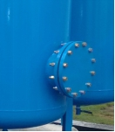
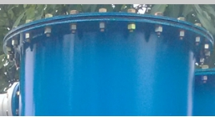
Desulfurizer replacement steps of biogas desulfurization system
Item | Replacement step method | Icon
1 | The replacement operation of the desulfurizer is carried out under the premise of ensuring that the gas source is cut off and the system is shut down.
2 | 1) Manually remove the manhole cover screw of the tank and remove the manhole cover plate (be careful to roll it to the hands and feet!); 2) Prepare the container to receive the overflowing desulfurizer under the manhole in advance.
3 | 1) Manually remove the screw of the tank feeding port cover; 2) Remove the cover manually or with a spreader (note that the cover is falling and hurting!!!) 3) The failed desulfurizer will fall freely from the bottom manhole and flow out; 4) If necessary, use an iron rod to pass the failed desulfurizer from the top of the tank until it is exhausted.

Slide 6


Desulfurizer replacement steps of biogas desulfurization system
4 | 1) The contact surface of the manhole flange is positioned with a strip of adhesive tape; 2) Manually install the manhole cover of the tank (pay attention to the hands and feet!) 3) Manually cover the manhole cover and tighten all the screws one by one in a symmetrical manner.
5 | 1) Add the effective desulfurizer from the feeding port above the tank until remaining a space of 10-15 cm high; 2) cover the top flange plus the sealing strip sealing flange contact surface; 3) Manually or by means of a spreader to cover the cover, tighten all the bolts one by one in a symmetrical way.
6 | When the system is inflated, use a foaming liquid (detergent water) to test the interface at the reinstalled flange and tighten the bolts at the leaking place until it doesn’t leak. | When the system is inflated, use a foaming liquid (detergent water) to test the interface at the reinstalled flange and tighten the bolts at the leaking place until it doesn’t leak.
Life cycle of Desulfurizer:
1）When H₂S content is 1000PPm, the usage time is 800h;
2）H₂S content is 1500PPm, the usage time is 500h;
3）H₂S content is 2000PPm, the usage time is 400h;
4）H₂S content is 3000PPm, the usage time is 250h;
5）H₂S content is 4000PPm, the usage time is 200h.

Slide 7
Biogas Flare operation
operation methods
（1）Flare inspection test.
1、When the flare and control equipment are installed, first check whether the gas supply pipe network is installed correctly, and whether there is leakage (the leak detection method is the same as the gas pipe network inspection standard).
2、Detect the adjustable parts of the gas supply, such as: whether the manual valve is open in its place.
3、Check if the wiring is correct and the motor is rotating correctly.
4、Other safety matters:
After the above determinations are correct, carry out the no-load (no fuel supply) test, check whether the flare operation program is normal, and confirm that it is correct before it can operate normally.
5、People need to be arranged for regular inspections during flare is running.
（2）How to start the flare：
1、Set the specific value of each pressure detector (can be set according to the biogas pressure on site).
2、Twist the start switch and the flare will automatically run according to the program.
3、After the flare is generally started, it will automatically run and close according to the setting parameters of the pressure detector under the normal condition of the flare power supply and air supply.
（3）When the flare system is to be shut down, you should:
1、First turn off the power of the control system, the flare will automatically turn off.
2、Close the manual valve on the biogas supply pipe.
3、Check whether every parts of the flare is running correctly and leave the site after confirming that they are correct.

Slide 8
Biogas Flare operation
Cautions:
1, The flare (including the heated kinetic energy equipment) should be installed in a well ventilated place away from inflammable and explosive objects. The overall safety distance of the flare should be around 20 meters.
2, The gas supply system is very important for the flare operation. It will cause downtime in the case of low pressure, shut-off, and low gas calorific value. The methane content of biogas should be regularly tested. When the methane content is less than 35%, it cannot be turned on.
3, The flare is ignited by the step-up transformer, and the voltage is 1000V. The ignition electrode is discharged by double electrodes, and the discharge gap is 3-5 mm to ensure the reliability of the ignition. The ignition electrode should not be disassembled and adjusted at will.
4, The flare tower should be well grounded.
5, eration of the flare. Once adjusted, the user should not adjust it at will.
(1) The electric valve of the flare is a key component for supplying and cutting off the gas. It should be inspected regularly, usually for 3-6 months.
(2) The leakage of the electric valve will cause an accident. To ensure safety, the electric valve should also be inspected and maintained regularly, generally no more than three months.

Slide 9
Common faults and maintenance of Biogas Flare
1、The electric valve is damaged or blocked.
Damage or blockage of the electric valve will result in fuel not being supplied to the burner, making the flare cannot be operated. If the solenoid valve has a similar failure, it is generally tested for its air tightness.
The method of inspection is: remove the core of the electric valve, discharge dust and impurities, check whether the sealing rubber pad is damaged, re-install after confirming the correctness. Please ask a professional to inspect, overhaul or replace.
2、Check if the valve wire is damaged or broken and clean the valve.
3、The carbon deposit on the ignition electrode will cause the electrode’s failure to discharge and ignite.
The maintenance method is to remove the electrode and wipe it with abrasive paper. The gap between the two electrodes should be adjusted to 3-5 mm.
Maintenance cycle is 3~6 months, pay attention to check valves, pressure detection, ignition condition.

Slide 10
THANK YOU

